Slide 1


Welcome DSCs
&
Invited Guests

Slide 2

Snapshot of Todays events
  Emerging issues & what’s new
  New prescription Glass program
  Minors in Labs Guidelines
  Fume Hood Safety networking
  Vendor presentations and NETWORKING
  Respiratory Protection
  3D Printing – Additive Manufacturing
  DSC to DSC Sharing successes and challenges
  Centrifuge Safety
  Introduction to BioRAFT
  Brainstorming session for 2019 ideas

Slide 3

Resources in your retreat binder
Research Safety Organization Chart & Contact Information
DSC Guidelines & Contact List
Minors in Labs
BioRaft
Reproductive Health Hazard Guidelines
Respiratory Protection | ₃D Print | Shop Safety
Safety Fact Sheets
Sponsor Vendor Information
2019 Evaluation Form / 2018 Review

Slide 4
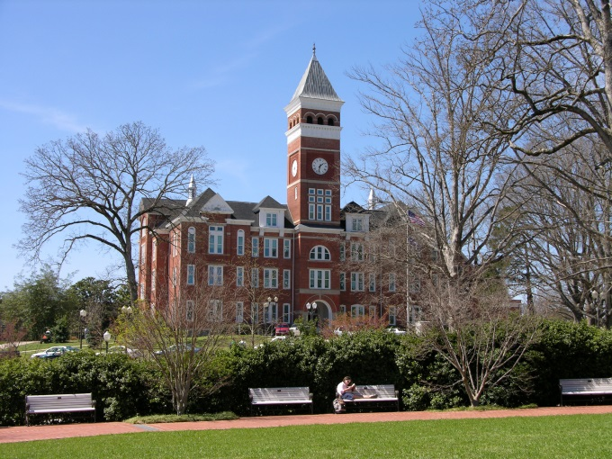
Office of Research Safety
http://www.clemson.edu/research/safety/
Easy to Work With
Technically Competent
Service Oriented
“We are committed to continuous improvement and exceptional customer service for our students, faculty and staff both on campus and across the state”
Email: researchsafety@Clemson.edu

Slide 5
2019-2020
BioRAFT
Service brochure
Website
Fact sheets
Fire Simulator/hands on training
TA safety training
First aid
Safety training
Safety for student clubs
Field Safety
Lab Safety Manual
Makerspace/3D printing
2 new positions

Slide 6
2019-2020
Tanner Finney, H&S Specialist
Jordanna Longo, H&S Specialist
Sam Forrest, Hazmat Specialist
Laura He, H&S Specialist
Jon Mengering, Hazmat Specialist
Bart Jennings, IT
CUICAR/Greenville
Safety Grant program
Prescription safety glasses
Minors in Labs

Slide 7


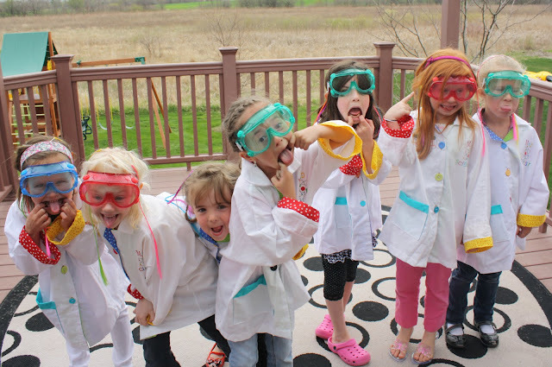
Minors in Labs

Slide 8

Why have minors in labs?
Where are they from?
Benefits of these programs
Summer camp
Volunteers
7th grade job shadow day
Give real experience in the science field to encourage participation.
Promote the Clemson brand and facilities
Free labor?
Lab in labs??

Slide 9

Pre-Collegiate Program Office (PcPO)
This office oversees ALL minors on campus.
“Minors” means anyone under the age of 18 who is not a Clemson student.
Anyone working with these individuals MUST enroll with the PcPO.
After going through the enrollment process, RS will be notified about minors in labs.

Slide 10



For these minors
Same requirements as anyone else in labs:
  Training: could specialized trainings to these groups
  Sign CHP acknowledgment page
  PPE provided and worn
  Added to IBC/AUP
  Minors should never be left alone and the “rule of three” should be followed.

Slide 11
Minors in Labs Guidance Document
Provided in your packet.
Applies to ages 14-17
Prohibits certain types of work (explosives, acutely toxic chemicals, etc.)
Allows for work with other hazards with additional oversight (carcinogens, radiation, BSL-2 labs)
Encourages communication with Research Safety

Slide 12

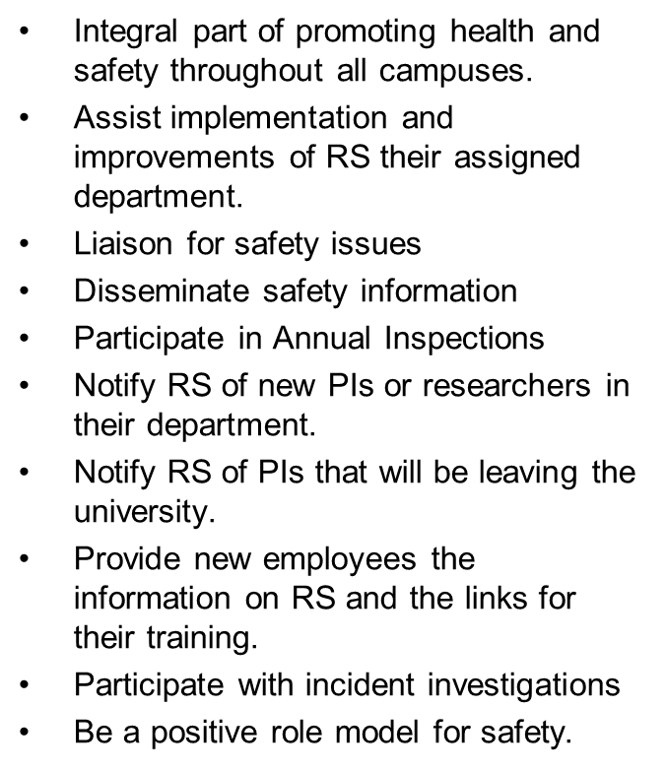
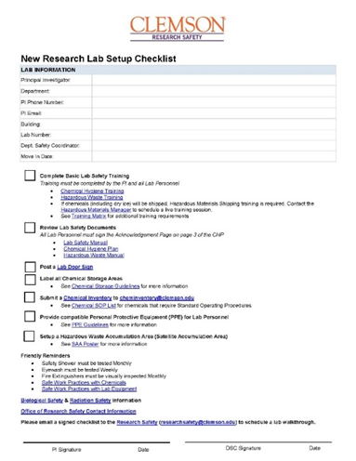

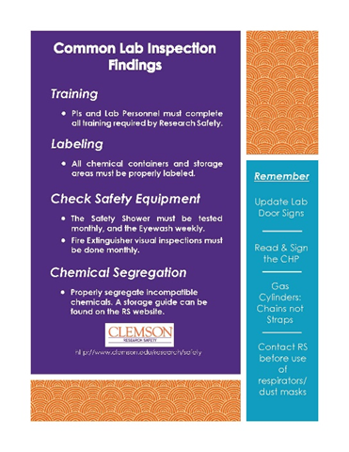
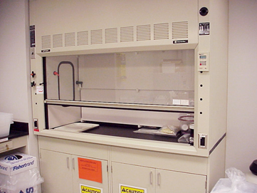
Department Safety Coordinators

Slide 13
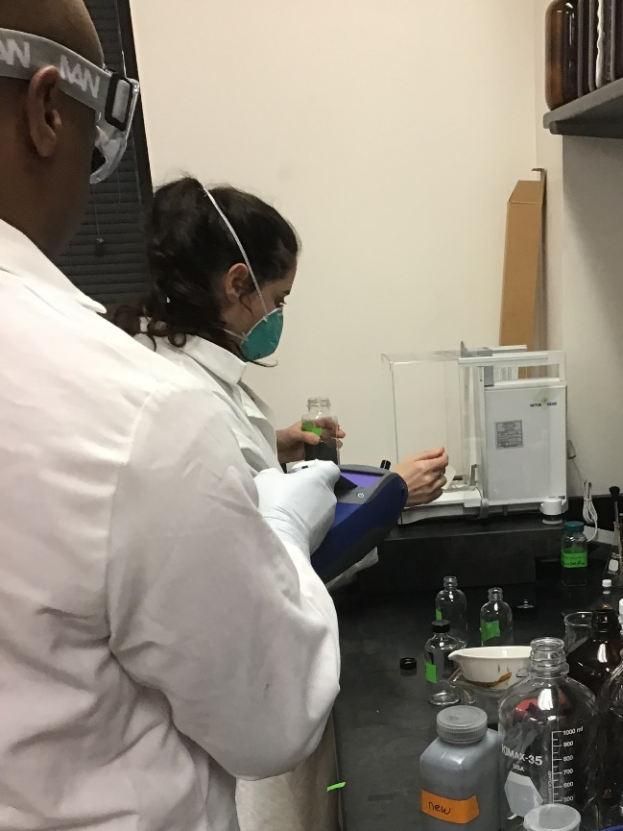

OFFICE OF RESEARCH SAFETY
Respiratory Protection Program
Shop Safety Improvements
₃D Printing w/ powders
Jeff Anthony
Industrial Hygienist
jantho3@clemson.edu
www.clemson.edu/research/safety

Slide 14
Respiratory Protection Program
Step 1: Respirator Selection and Used Form
If Research Safety determines that your job function will require respiratory protection, you must be enrolled in the Clemson University Medical Surveillance Program.
Step 2: Medical Surveillance Form
Fax: (864)656-1123
Regular mail: Medical Surveillance Program, Joseph F. Sullivan Center, 101 Edwards Hall, Clemson University,
Attention: Angela Reid. Note that it may take up to ten(10) business days.
Step 3: Respirator Training
Step 4: Fit Testing: Jeff Anthony at jantho3@clemson.edu to schedule an appointment.

Slide 15
Respiratory Protection Program
If your job does not require use of a respirator but you want to use a dust mask for comfort reasons, please complete the below form and send to Jeff Anthony at jantho3@clemson.edu
Appendix D – Voluntary Dust Mask Use Form
IAW: OSHA 1910.134. The program includes medical surveillance, training, and fit-testing.
N-95
■ Dust masks or particle masks
■ Half masks, with cartridges
■ Full facepieces with cartridges;
■ Loose-fitting hoods or helmets that cover the head completely
■ Atmosphere-supplying: Airline Respirators or Self Contained Breathing Apparatus.

Slide 16
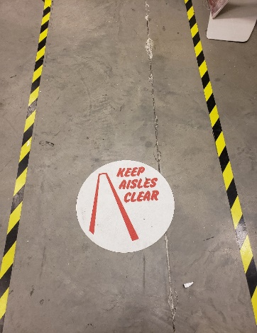
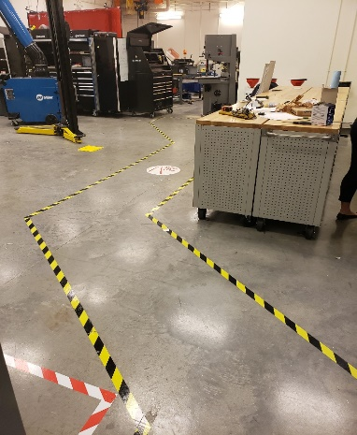
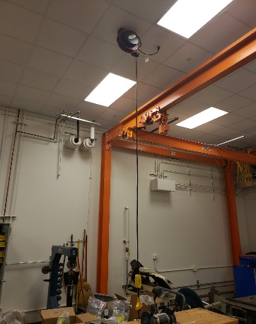
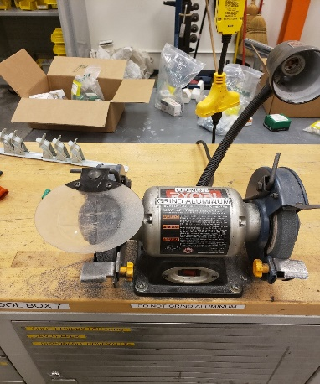
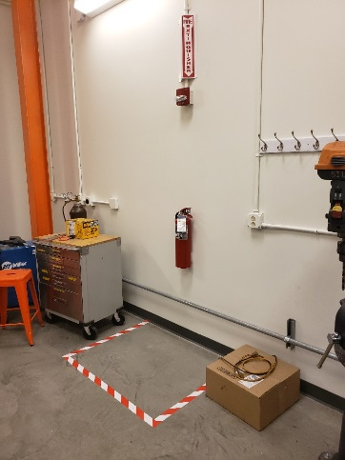
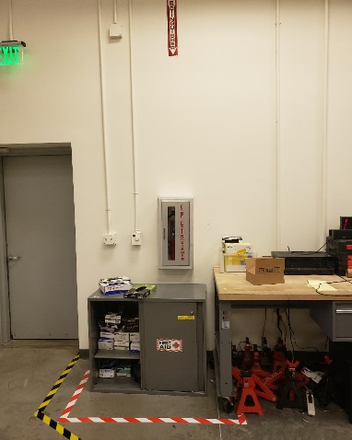
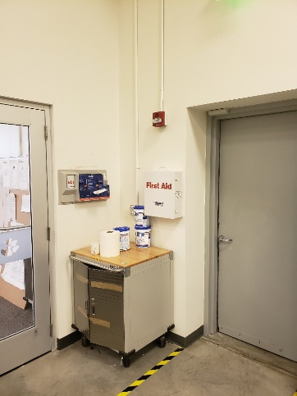
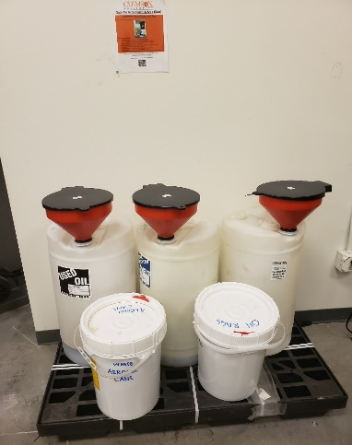
Deep Orange Lab

Slide 17
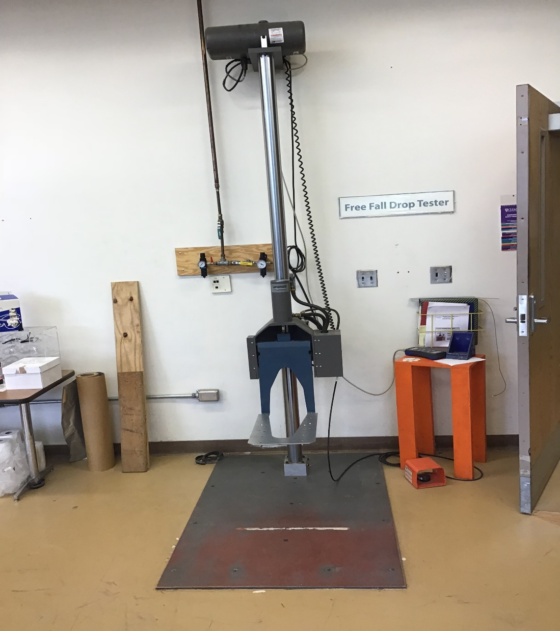
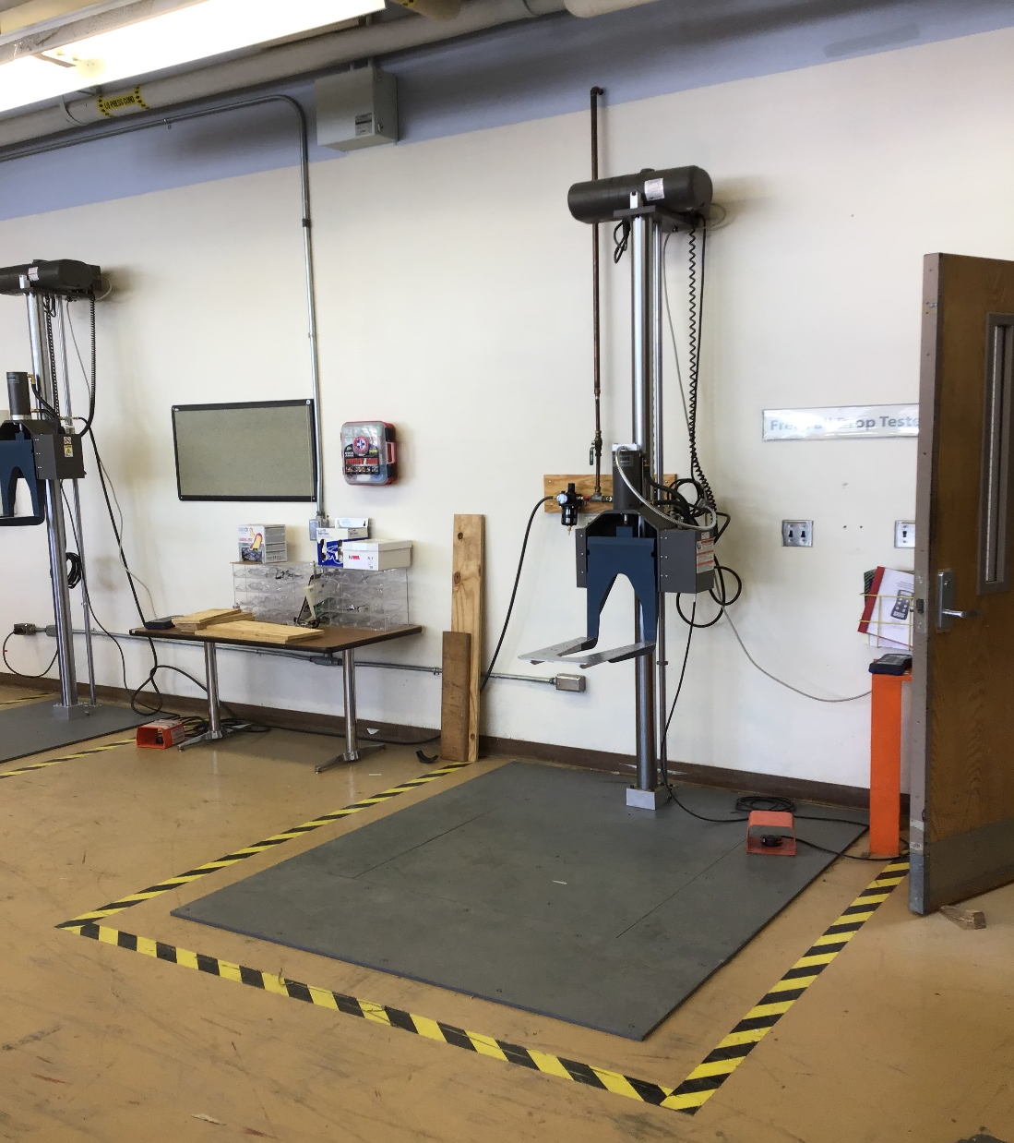

Slide 18
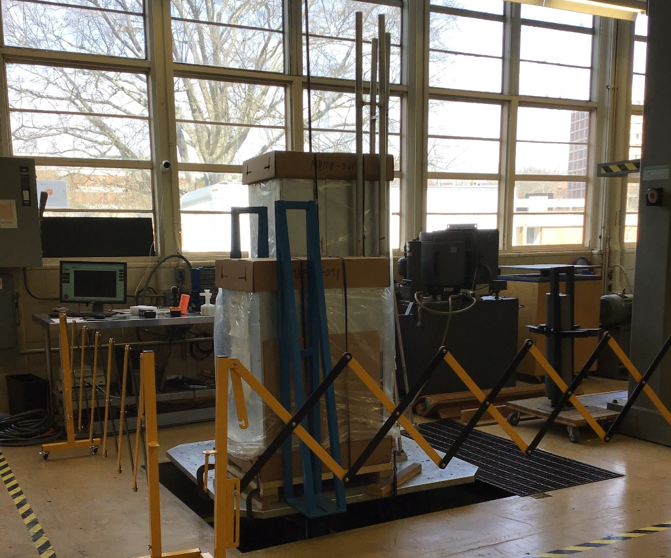
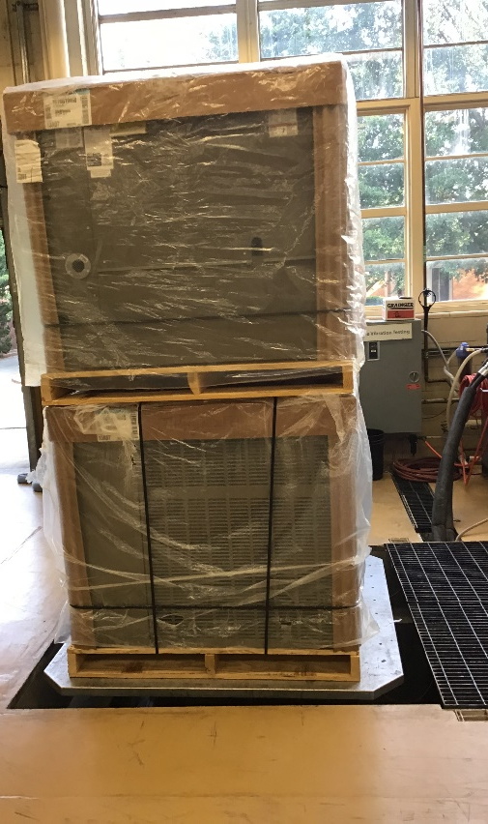
P & A

Slide 19
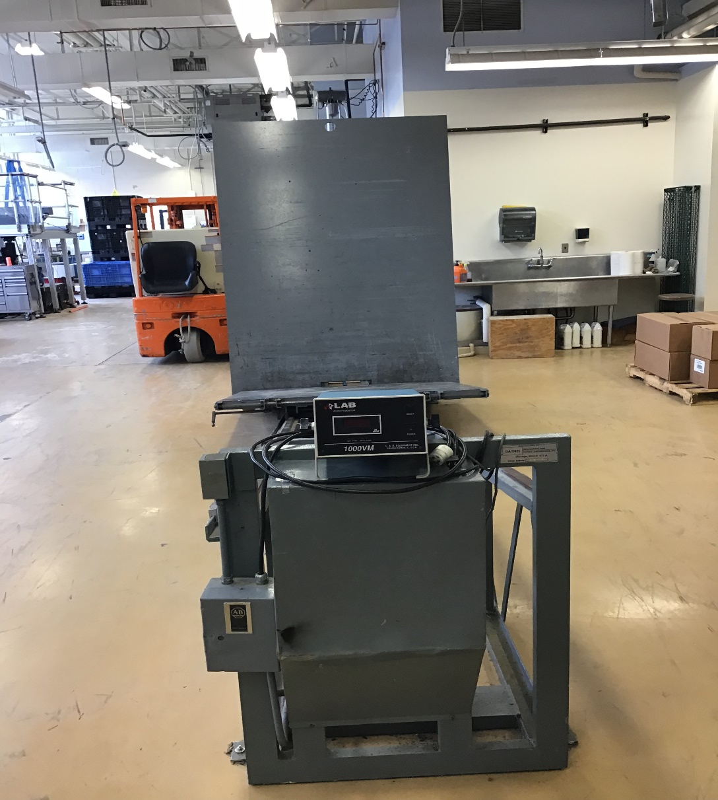
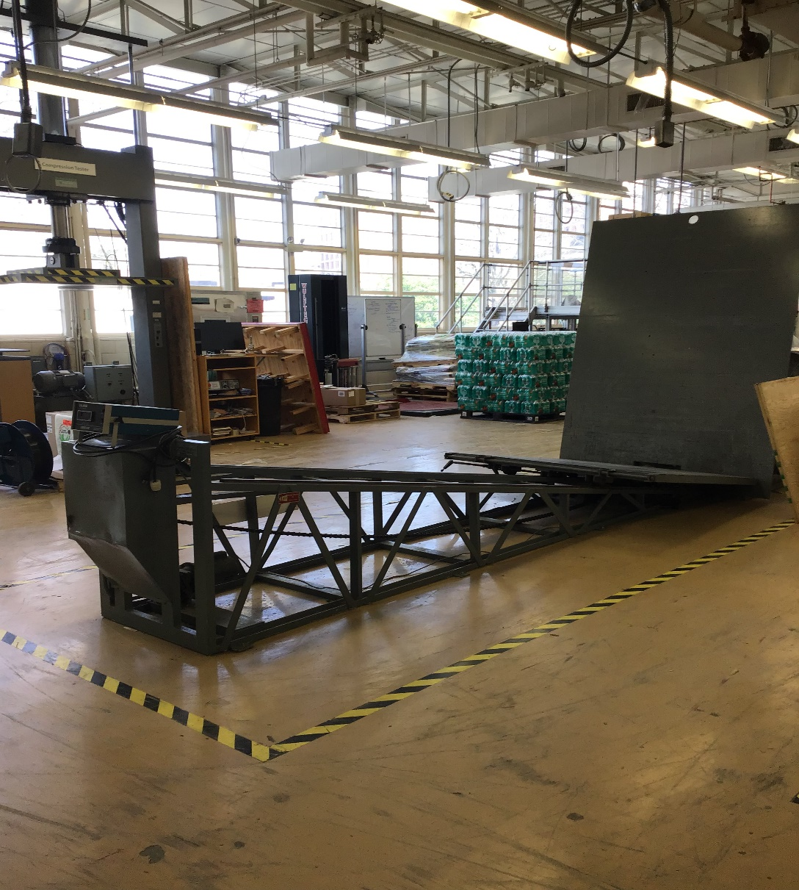

Slide 20
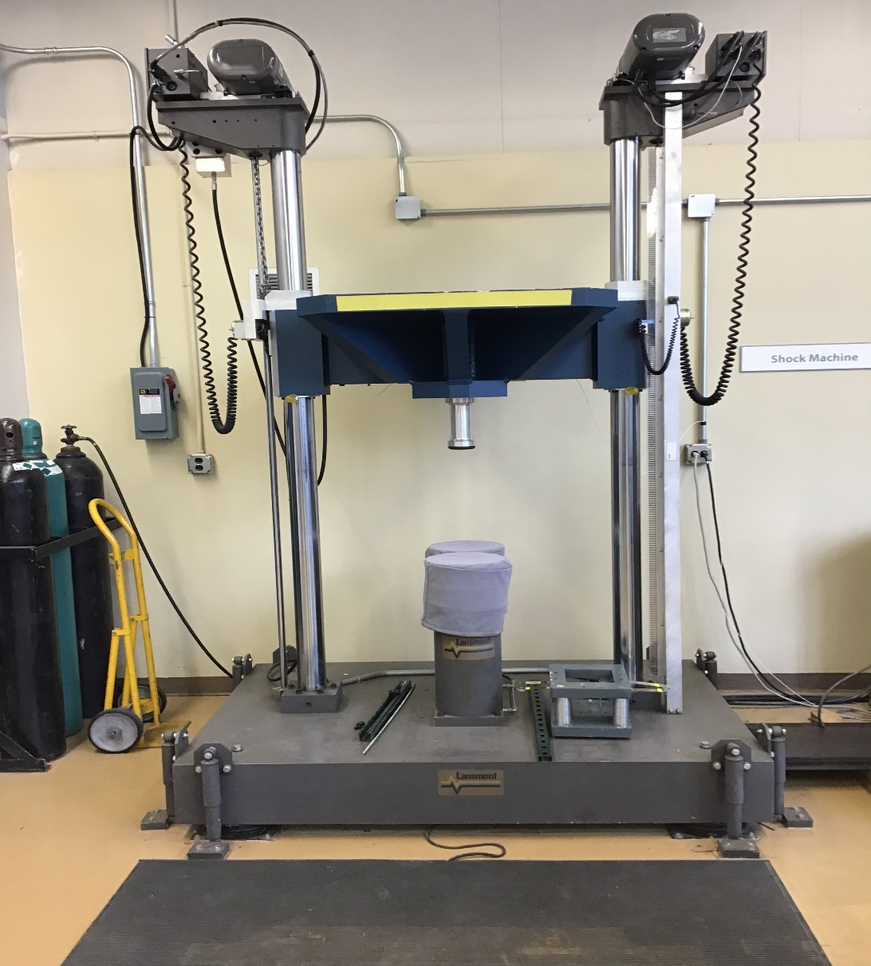
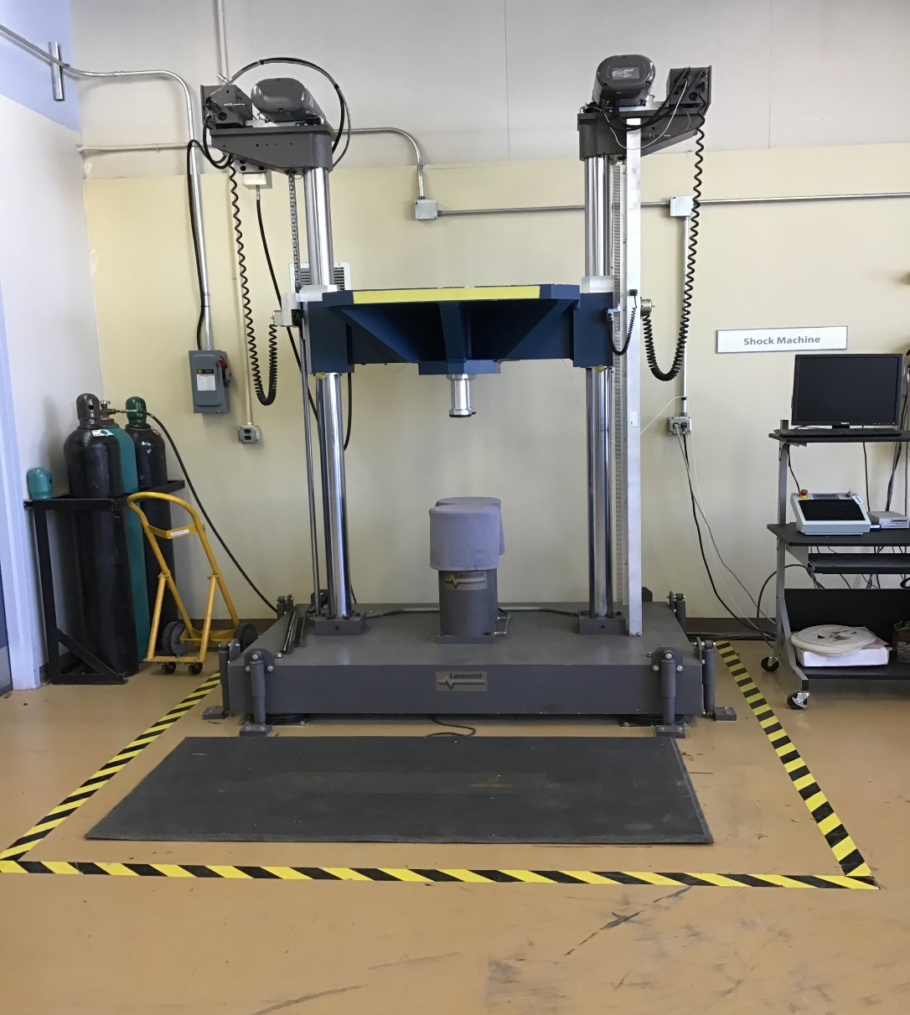

Slide 21
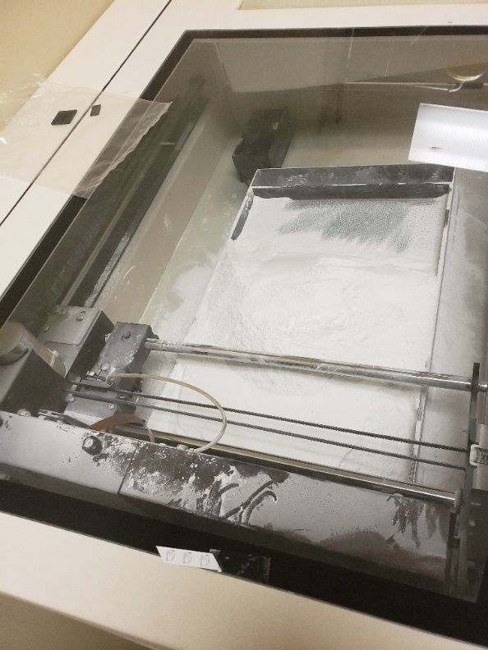
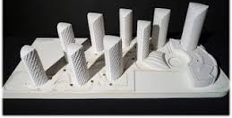
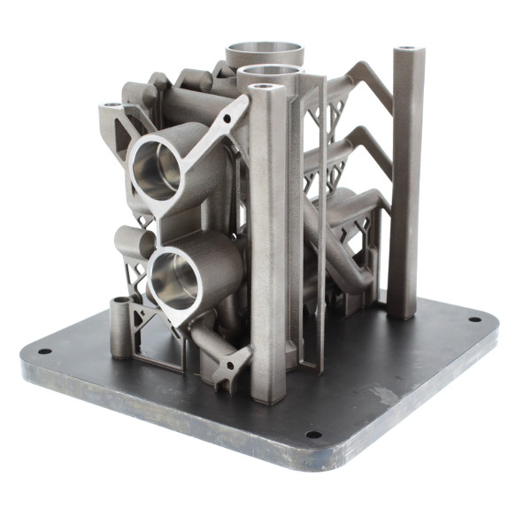

3D Printing w/ Powder
NFPA 652, 654 and 484 (specifically for metallic dusts)
https://www.ncbi.nlm.nih.gov/pmc/articles/PMC5553103/

Slide 22
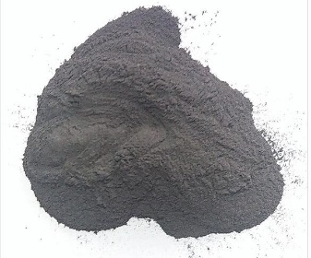
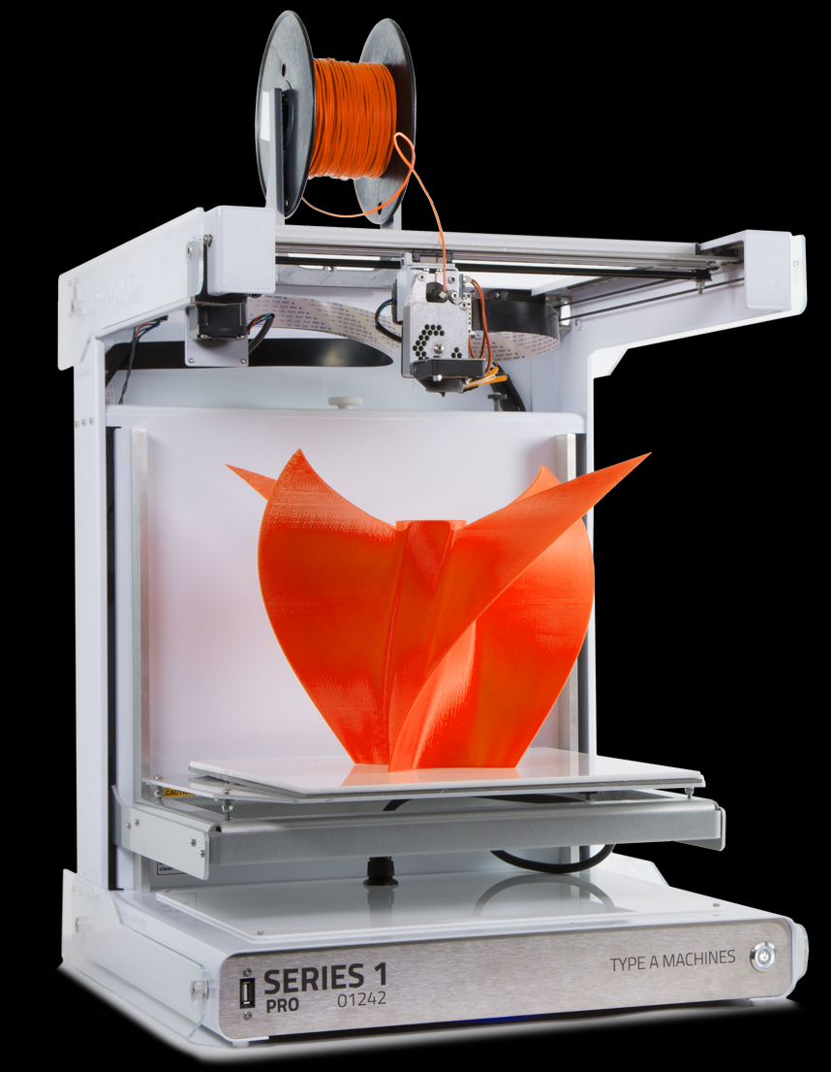
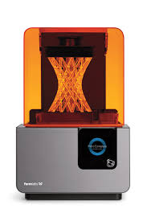
Chemical Hazards with 3 D printers
Particulate
  FDM using PLA Ultrafine particles
  FDM using ABS Ultrafine higher than PLA
  SLA lower than FDM printing
  Powder, smoke, soot
Chemical
  FDM ABS chemical styrene, acrylonitrile
  DLA – resins, Methyl methacrylate
  Coatings –FDM nylon
Rinsing and Finishing
  Alcohols
  Acetone
  Sodium Hydroxide – caustic bath
  Soldering – particulate emissions

Slide 23
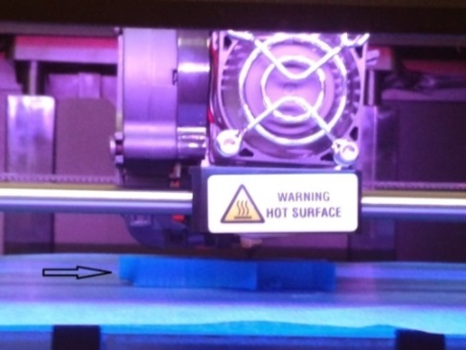
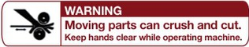

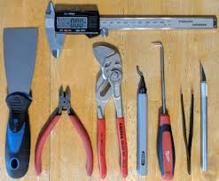
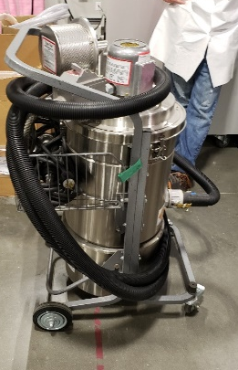
Physical Hazards with 3 D printers
Hot Surfaces: (print head; freshly printed plastic, heated bed)—fire or burn hazard. Machines labeled.
Moving parts: pinch point or entanglement hazard. Labeled points and no loose clothing, hair tied back – Machines labeled
Sharp objects: scalpels, knives, screwdrivers, hand tools, Metal spatulas work best
Heavy objects: bone fractures/breaks, lacerations, bruising, back injuries
Electricity: shock or fire hazard (combustible dust environment)
UV/Laser radiation: eye and skin burns
Noise Levels >85dB: Equipment vibration/ mechanical noise, vacuum operation
Pneumatic equipment / inert gas supply: low oxygen level environment, compressed air into skin may cause an embolism
Follow Manufacturers instructions
No DIY printers or printers without heat sensors.
Maintain equipment properly.
Label hazards

Slide 24
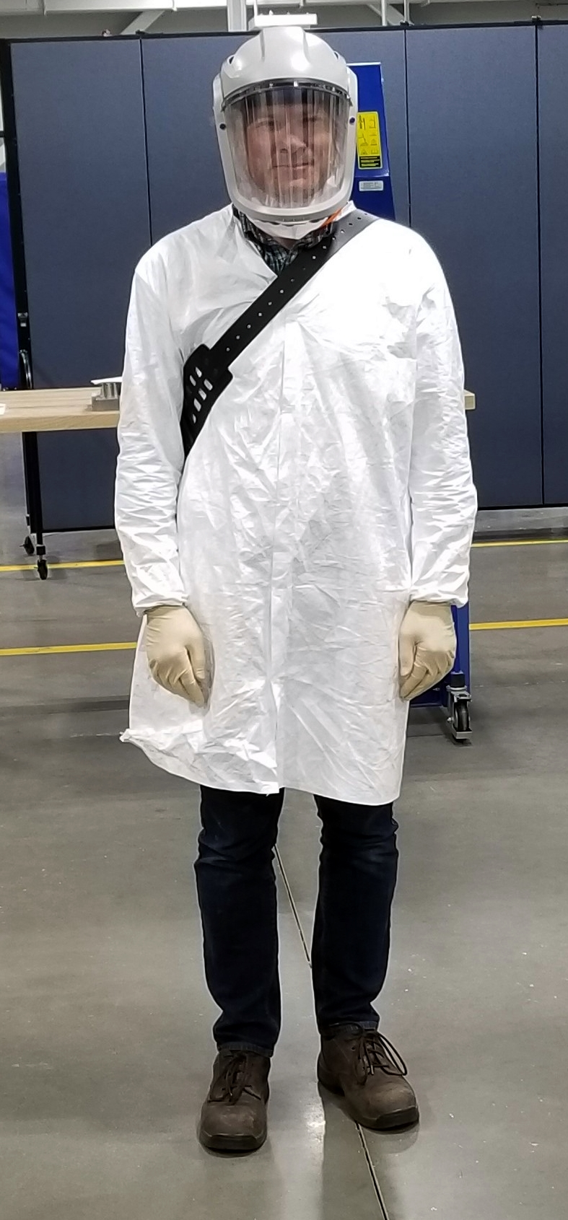
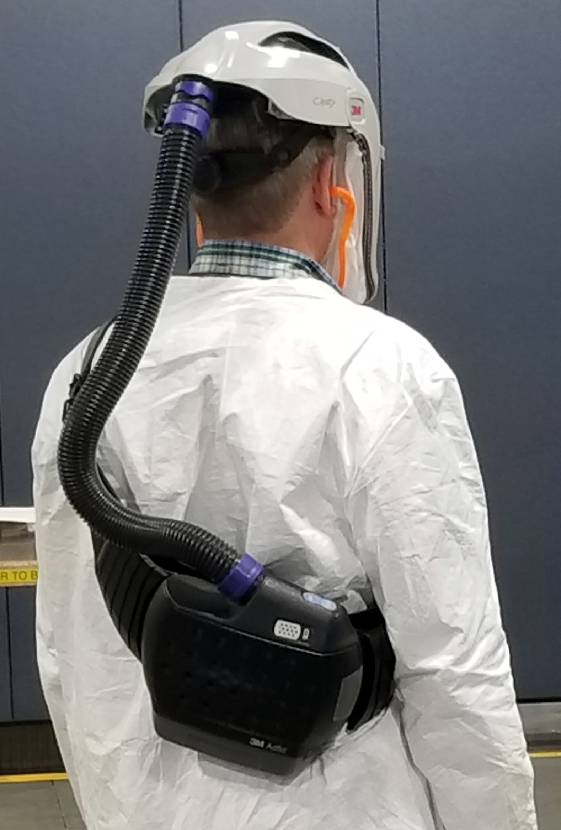
PPE
Positive Pressure Mask & Fan/Filter Unit
To be used when powder can become airborne
Tyvek Coat
To be worn when working with powder
Latex Gloves
Ear Plugs
To be worn when working with powder
To be worn during high noise levels
Steel Toe Shoes
To be worn at all times

Slide 25

Introducing
An intuitive software management system that collects, organizes and displays a wide range of real time safety data to improve visibility, reduce risk and increase productivity across research and EHS.
The integrated modules will:
Streamline inspections based on risk criteria
Manage chemical inventories with a chemical database for regulatory reports and search for chemical hazards
Track safety equipment, and
Identify and track specific training needs.
A sustainable database of people, spaces, hazards and job activities which will be the foundation for keeping the research community safe across all of our campuses.
60.5% on average reduction in time spent by researchers on the top 15 common safety tasks.

Slide 26
Web based and hosted
Single sign in with Clemson User ID
For visiting faculty, students, interns or contractors that do not have a Clemson user ID.
  Send a request to bioraftrshelp@clemson.edu and include the person’s name, department, supervisor, and email. (Can get ID within 30 minutes for normal business hours.)
Information is viewable only to authenticated and authorized individuals based on the individual needs:
  Administration, compliance and safety can view high-level information
  Principal Investigators in a lab or research area can see relevant information only about their lab and lab members.
  Individual researchers can see only their information and certain information about their lab’s activities (depending on their role/job duties).
  DSCs will see information about their departments.

Slide 27
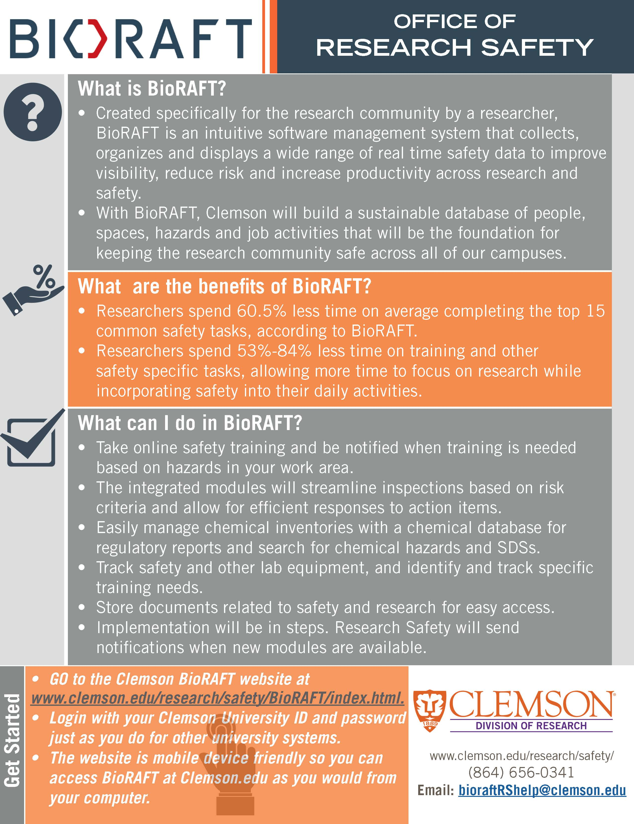
Platform Module
Who what where
All research areas
All campuses
Training Module
  Assigns training by hazards
  Hosts online training
  Sign up for training
  Tracks training
Inspection Module
  Standardized checklists
  Easy follow-ups
  Statistics
Chemtracker & SDS
  Easy chemical inventory
  Preloaded chemicals & hazards
  SDS links
  Export excel into inventory
Equipment module
  Safety and lab equipment
  Fume hood tracking & repairs

Slide 28
BioRAFT offers several different “modules” for specific tasks, such as inventorying chemicals, scheduling inspections or meeting training requirements. Those modules will be implemented in the following steps: Aug. 1 - BioRAFT Platform Bioraft is now live for PIs and supervisors to set up their labs and work areas. Aug. 15 - Training Module - Online training becomes available. Sept. 30 - Inspection module becomes available. Oct. 30 - Chemtracker and SDS module becomes available. Nov. 30 - Equipment module becomes available. The Office of Research Safety will send email notifications from the BioRAFT platform when new modules are available.

Slide 29
PI Lab Set Up

Slide 30
Training Dashboard

Slide 31
Training Sign In

Slide 32
Chemtracker Module

Slide 33
Inspection module

Slide 34
DEMONSTRATION

Slide 35
UPDATE from
Retreat DSC Brainstorming and Q&A
Location of the venue. Maybe larger area with more vendors. Moved to Hendrix Center. Doubled vendor participation.
Students – Most will be addressed by Bioraft. Matrices may still need to be developed.
  Safety Training for grad students
  Training
    +1hr Cr Course
    Safety training record access for DSCs and PIs
    PI Spreadsheet for Student Specialty Training – who needs what
Youth/Children (Camps/Visits) Minors in labs policy and guidelines developed.
  Tracking/ Prior Notification
  Lab Orientation/ Lab Safety Training Plan
  Minors in Labs Policy and guidelines.

Slide 36
UPDATE from
Retreat DSC Brainstorming and Q&A
Visiting Researchers Will be addressed by BioRAFT.
  Tracking/ Prior Notification
  Lab Orientation/ Lab Safety Training Plan
  Access to training materials outside of username/password format
Desired Trainingsavailable on line and in person
  Compress Gas Cylinders Online course developed for Bioraft.
  Arc Flash Online course developed for Bioraft and electrical safety
  Machine Guarding / Interlocks Online course developed for Bioraft
Machine Shop Issues
  Management and chain of custody of Chemicals
    Chemical Inventory BIORAFT
  Inspections BIORAFT module will add specific inspection checklists
    HazCom
    Fire/Life Safety
    Gen Shop Safety

Slide 37
Questions?
Office of Research Safety
http://www.clemson.edu/research/safety/
Email: researchsafety@Clemson.edu
“We are committed to innovation and exceptional customer service
for our
students, faculty and staff
both on campus and across the state”

Slide 38

Thank You For All you Do to promote a positive safety culture!

